Slide 1
DriverPass System Design
CS 255 – Systems Analysis and Design
Project Two: Client Presentation
Prepared by: Hetal Ram
Southern New Hampshire University
Notes:
Hello everyone. My name is Hetal Ram, and today I will present the system design for DriverPass. DriverPass is an online system that helps customers prepare for their driving tests by providing practice tests, scheduling driving lessons, and managing appointments. In this presentation, I will explain the main features of the system, how it meets the client's needs, and the security and technical requirements that support the system.

Slide 2
System Requirements
Web-based and cloud-hosted system
Online practice tests
Schedule driving lessons
Manage appointments
Secure login and role-based access
Access from computers, tablets, and mobile devices
Notes:
The DriverPass system is a web-based application that customers can access from computers, tablets, or mobile devices. The system allows customers to take practice tests, schedule driving lessons, and manage appointments. It also provides secure login and protects customer information. The system is designed to support multiple users while maintaining reliable performance.

Slide 3
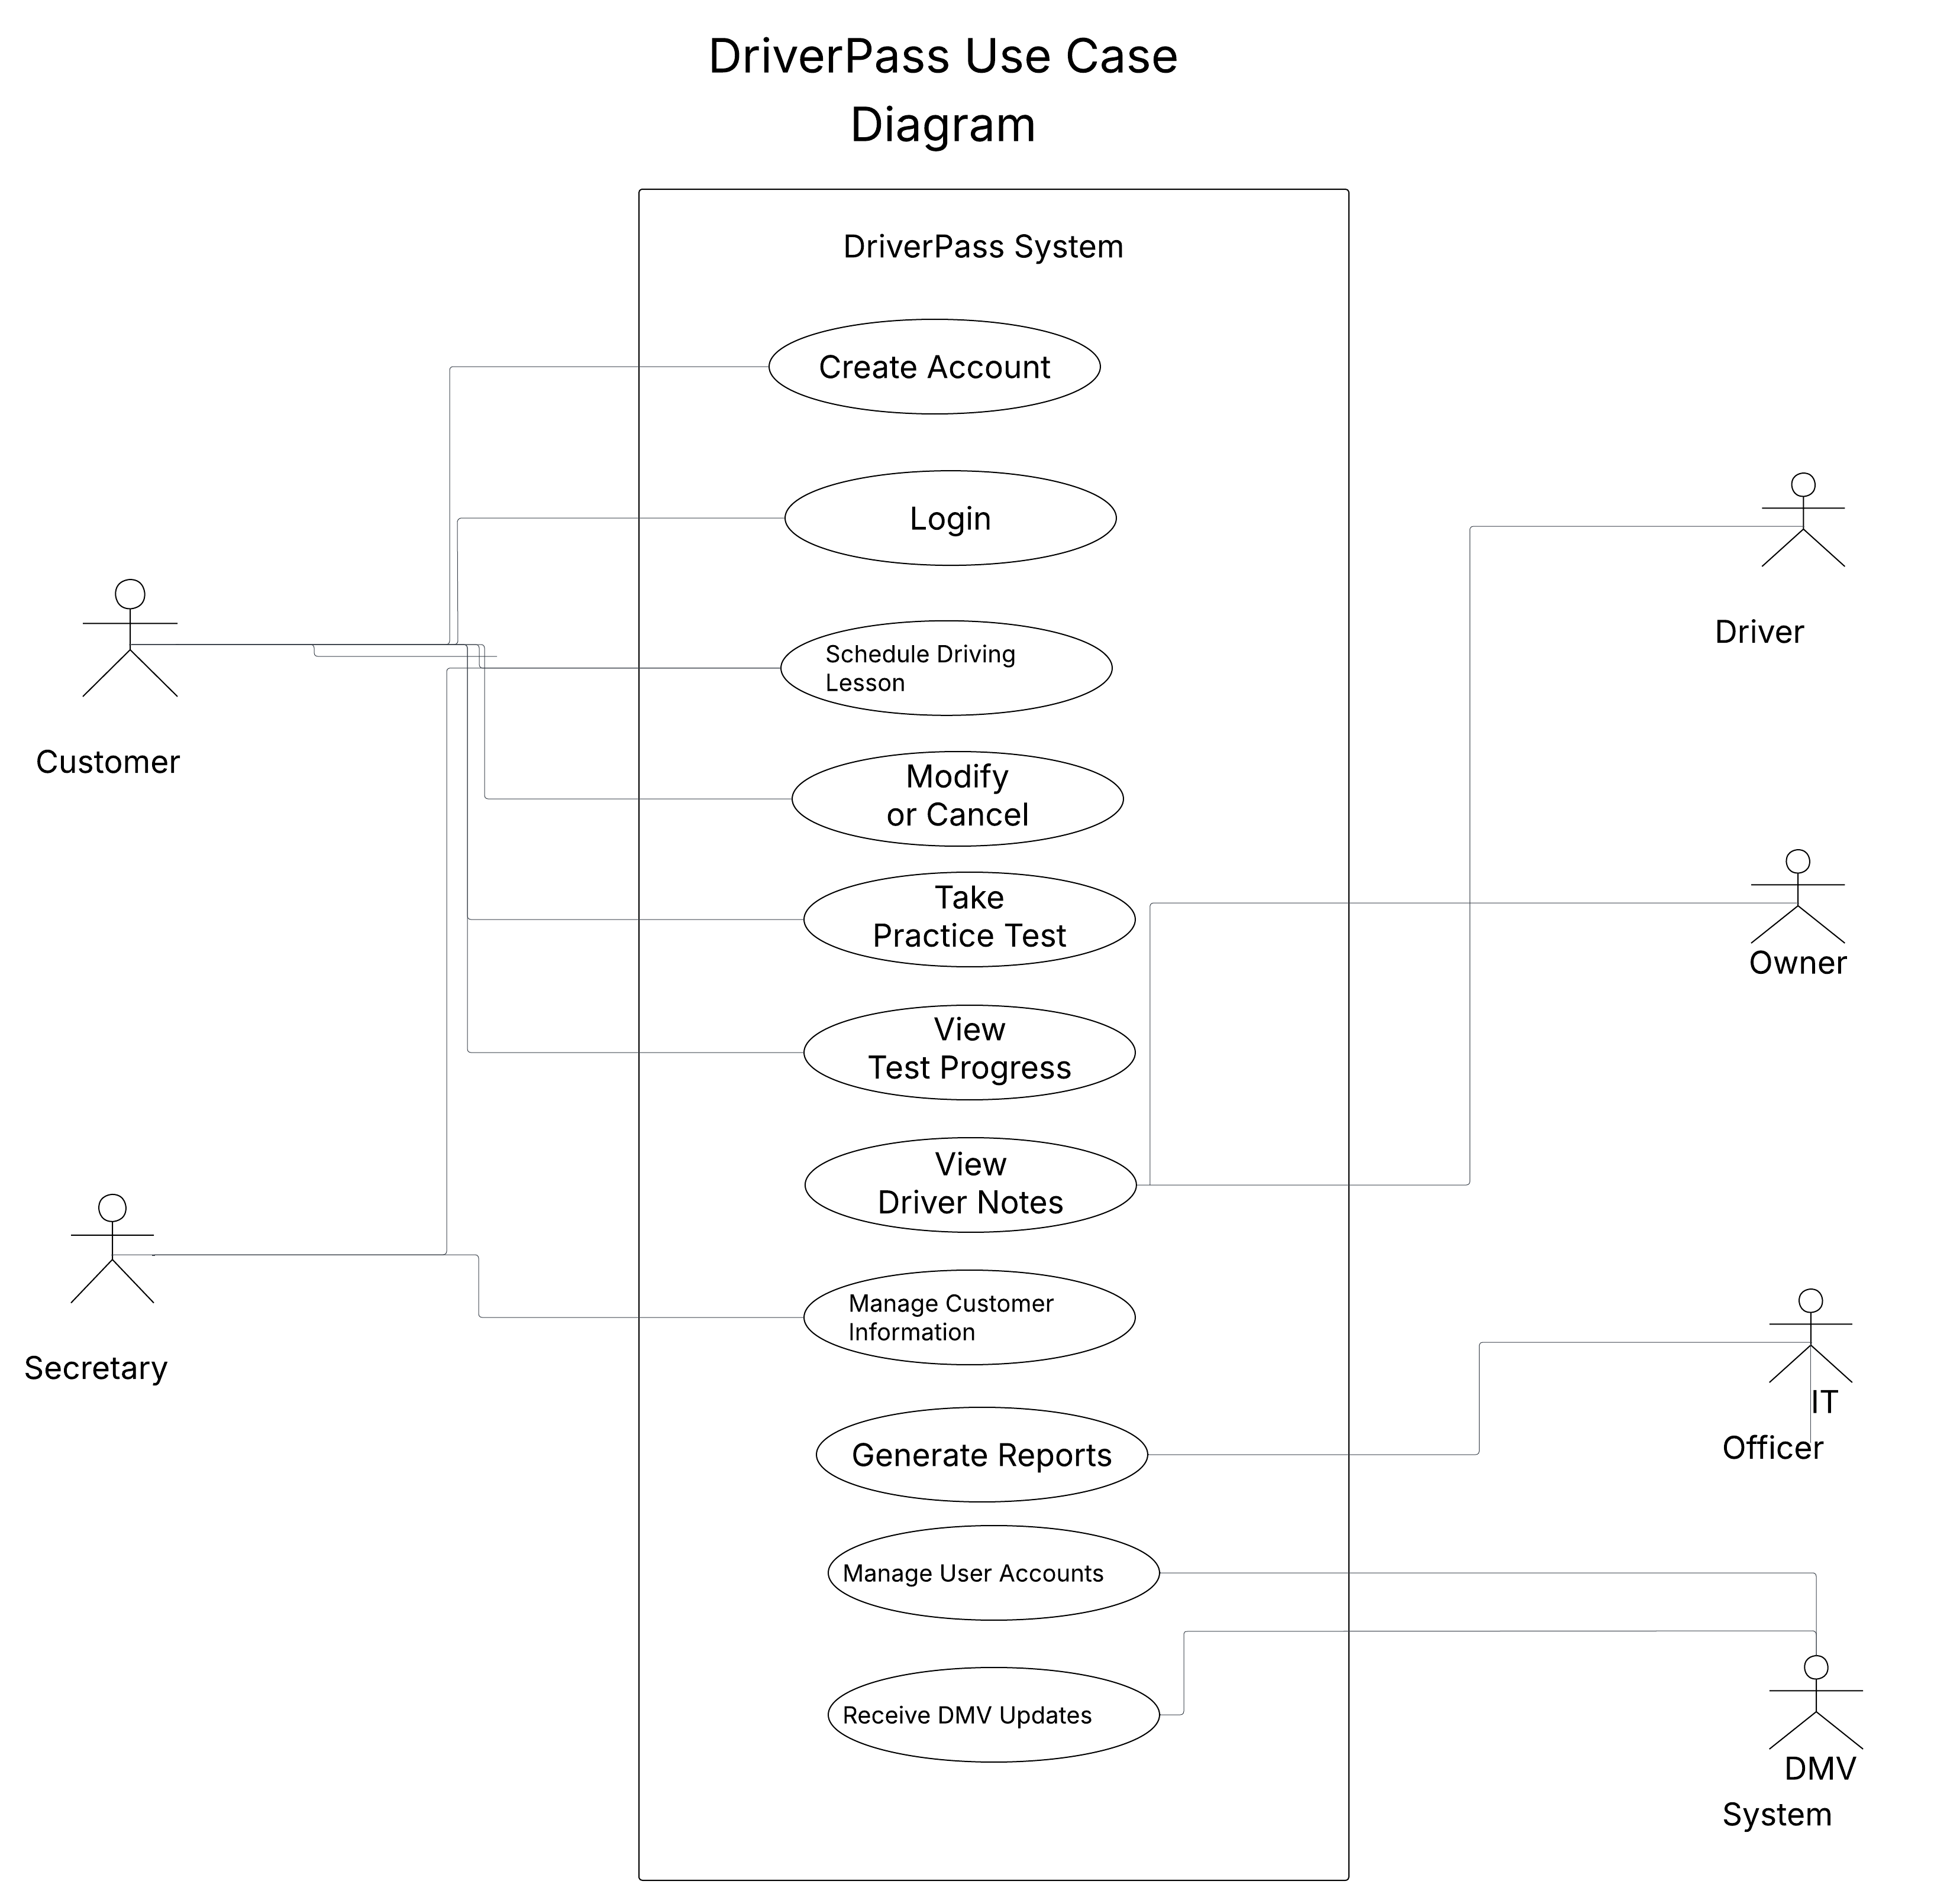
Use Case Diagram
• Shows the main users of the DriverPass system
• Demonstrates how users interact with system functions
Notes:
This Use Case Diagram provides a high-level overview of the DriverPass system. The main users are customers, secretaries, drivers, owners, IT officers, and the DMV system. Customers can create accounts, schedule driving lessons, take practice tests, and view their progress. Staff members can manage customer information, generate reports, and manage user accounts. This diagram helps explain how different users interact with the system and how the system meets the needs of DriverPass.

Slide 4
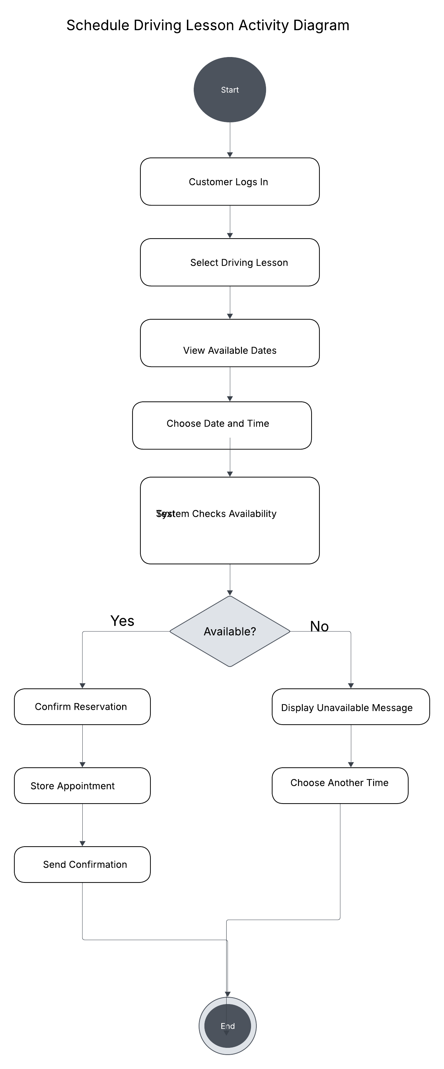
Activity Diagram
Schedule Driving Lesson Activity Diagram
Shows the steps for scheduling a driving lesson
Demonstrates how the system checks availability and confirms appointments
Notes:
This Activity Diagram shows the process a customer follows to schedule a driving lesson. The customer logs in, selects a driving lesson, views available dates, and chooses a preferred time. The system checks whether the selected time is available. If the time is available, the appointment is confirmed and a confirmation message is sent. If the time is unavailable, the customer can choose another time. This process helps provide a smooth and organized scheduling experience for customers

Slide 5
Security
Secure username and password login
Role-based access for different users
Encrypted customer information
Password reset functionality
Account monitoring and protection
Notes:
Security is an important part of the DriverPass system. Users must log in with a secure username and password before accessing the system. Different users, such as customers, instructors, administrators, and IT staff, have different levels of access based on their roles. Customer information is protected through encrypted data transmission and account monitoring. The system also provides password reset functionality and can notify administrators after repeated failed login attempts to help protect user accounts.

Slide 6
System Limitations
Requires a stable internet connection
Depends on DMV updates
Performance may vary with network speed
Future growth may require additional resources
Requires secure cloud hosting
Notes:
The DriverPass system has a few limitations. The system requires a stable internet connection because it is web-based and cloud-hosted. It also depends on DMV updates to keep practice tests and driving information current. Performance may vary depending on network speed and the number of users accessing the system at the same time. As DriverPass grows, additional resources may be needed to support more users and services. Despite these limitations, the system provides a secure, reliable, and scalable solution for DriverPass.

